Slide 1
Load Balancing on SDN
Anand Wani (2018H1030143P)
Bhavik Dhandhalya (2018H1030118P)

Slide 2
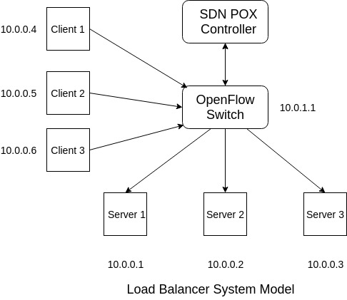
System Model

Slide 3
Implementation Challenges
Mininet specific:
vlan port while installation(only NAT available)
not able to install external packets like (iperf, http-perf)
“random.py” file name
Project specific:
ARP packets to check whether servers are alive or not
calculating RTT
give servers capacity
give packets weight

Slide 4
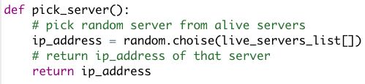
Random Algorithm

Slide 5
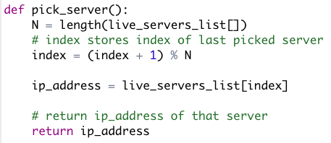
Round-Robin Algorithm

Slide 6
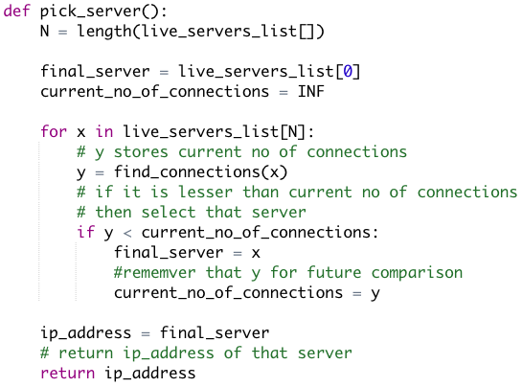
Least Connection Based

Slide 7
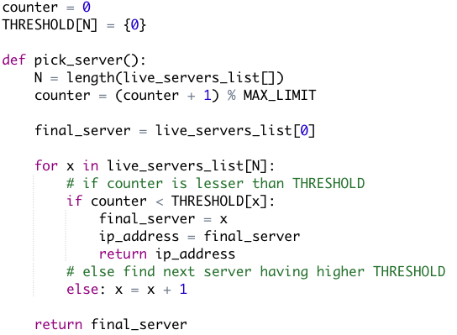
Weighted RR

Slide 8
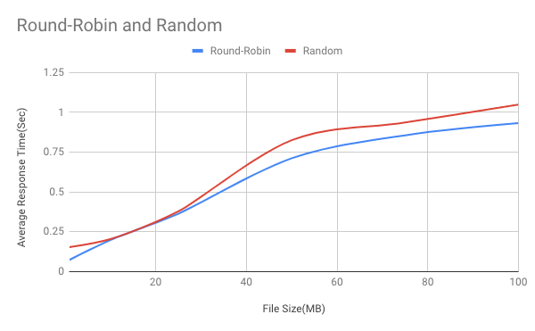
Random vs RR
File Size | Round-Robin | Random
1 | 0.07395833333 | 0.15375
10 | 0.198125 | 0.2039583333
25 | 0.3635294118 | 0.3782352941
50 | 0.7115686275 | 0.8249019608
75 | 0.8558823529 | 0.9360784314
100 | 0.9323529412 | 1.048431373

Slide 9
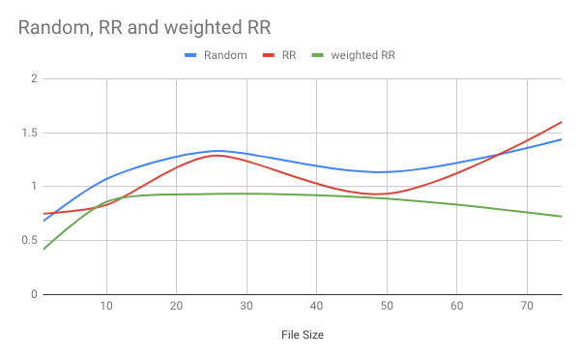
50 * 3 iterations
File Size | Random | RR | weighted RR
1 | 0.680333 | 0.749 | 0.418
10 | 1.07033 | 0.829667 | 0.859
25 | 1.32833 | 1.28533 | 0.932333
50 | 1.13467 | 0.933333 | 0.889
75 | 1.438 | 1.6 | 0.722333

Slide 10
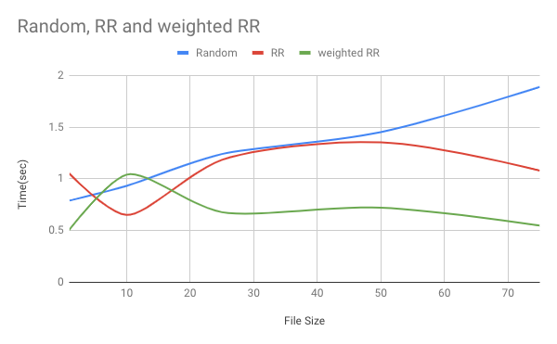
100 * 3 iterations
File Size | Random | RR | weighted RR
1 | 0.7895 | 1.0505 | 0.5085
10 | 0.932167 | 0.6505 | 1.04017
25 | 1.23967 | 1.18317 | 0.677333
50 | 1.45217 | 1.35267 | 0.721167
75 | 1.8885 | 1.0795 | 0.548333

Slide 11
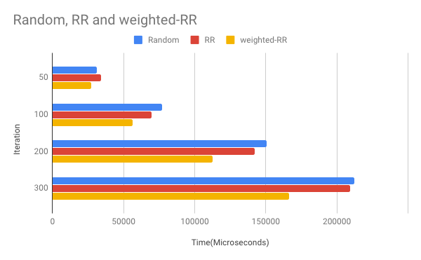
Turn Around Time (packets with diff. size)
Iteration | Random | RR | weighted-RR
50 | 31388.804 | 33997.289 | 27375.259
100 | 77032.588 | 69841.801 | 56255.486
200 | 150419.423 | 142287.505 | 112495.153
300 | 212460.915 | 209429.211 | 166604.749

Slide 12
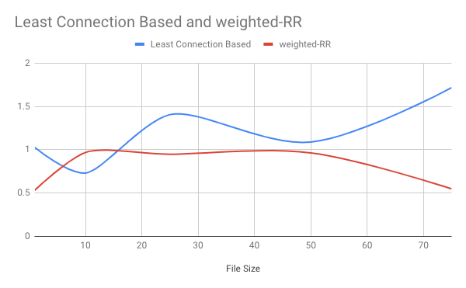
Least Connection vs weighted-RR
File Size | Least Connection Based | weighted-RR
1 | 1.02533 | 0.533667
10 | 0.73 | 0.969
25 | 1.4055 | 0.947667
50 | 1.08867 | 0.9635
75 | 1.71617 | 0.548167

Slide 13
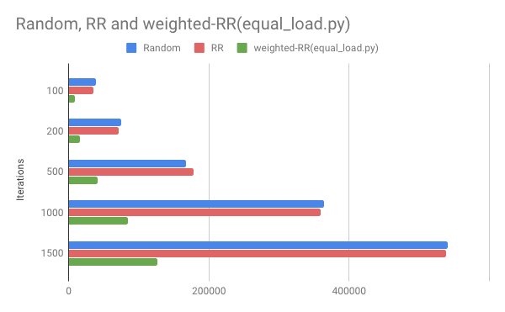
Turn Around Time (packets with same size)
Iterations | Random | RR | weighted-RR(equal_load.py)
100 | 38496.255 | 35544.115 | 8444.825
200 | 74705.323 | 71727.752 | 16428.513
500 | 167638.835 | 178612.654 | 41555.514
1000 | 364786.688 | 359001.205 | 84330.728
1500 | 540187.439 | 538257.512 | 126570.55

Slide 14
Thank You !!

